Slide 1
Dual Problem
The dual problem:
Given the training sample {(xi,di)} ,find the Lagrange multipliers {(α _{i})} that maximize the objective function
subject to the constraints
for i=1,2,…,N
<x_{i},x_{j}>
The dual problem is cast entirely in terms of the training data.
Q(α) to be maximized depends only on the input patterns in the form of dot product.

Slide 2
Classifying new data points
Once the parameters (α*, b*) are found by solving the required quadratic optimisation on the training set of points, the SVM is ready to be used for classifying new points.
Given new point x, its class membership is sign[f(x, α*, b*)], where
Data enters only in the form of dot products!

Slide 3
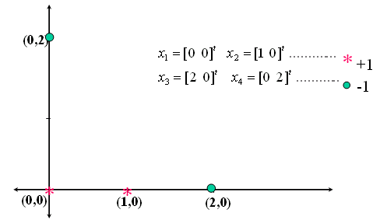

Slide 5
Non-linear SVMs: Feature spaces
Φ: x → φ(x)

Slide 6
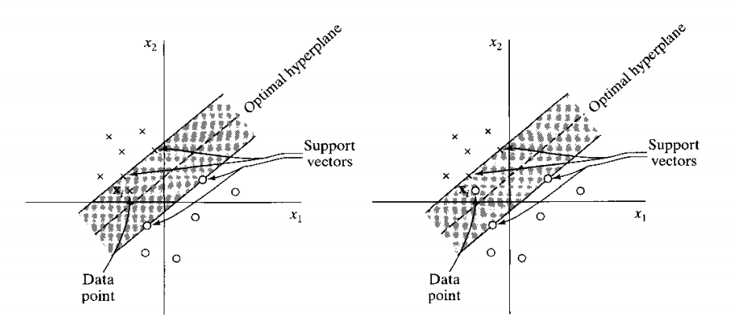
Non-Linearly Separable Data
The margin of separation is soft if the condition is violated

Slide 7
Non-Linearly Separable Data
Var₁
Introduce slack variables
Allow some instances to fall within the margin, but penalize them
Var₂

Slide 8
Formulating the Optimization Problem
Constraint becomes :
Objective function penalizes for misclassified instances and those within the margin. Introducing extra cost term
C trades-off margin width and misclassifications
Var₁
Var₂

Slide 9
Linear, Soft-Margin SVMs
As C→∞, we get closer to the hard-margin solution
Soft-Margin always have a solution
Smoother surfaces (in the non-linear case)
do not appear in the dual problem

Slide 10
Robustness of Soft vs Hard Margin SVMs
ξi
Soft Margin SVN
Hard Margin SVN

Slide 11
The Soft-Margin Classifier cont.
Lagrangian for soft margin problem is
with and Differentiating w.r.t. w, and b
(1)
(2)
(3)
(4)
Substituting (2),(3),(4) into primal Lagrangian (1)
we can form the dual formulation for soft margin problem

Slide 12
The Soft-Margin Classifier cont.
Lagrangian for soft margin problem is
with and Differentiating w.r.t. w, and b
(1)
(2)
(3)
(4)
Substituting (2),(3),(4) into primal Lagrangian (1)
we can form the dual formulation for soft margin problem

Slide 13
Soft Margin-Dual Lagrangian
Dual problem
The nonseparable case differs from the separable case in that the constraint is replaced with the more stringent constraint

Slide 14
1. What is SVM?
How to formulate the SVM problem as an optimization problem?
Why do we solve the dual problem?
What to do if the data is not linearly separable?
What is meant by a linear Kernel?
A kernel is a similarity function. It takes two inputs and tells how similar they are.
Under some conditions, every kernel function can be expressed as a dot product in a (possibly infinite dimensional) feature space
Many machine learning algorithms can be expressed entirely in terms of dot products.

Slide 15
Linear Classifiers in High-Dimensional Spaces
Constructed Feature 2
Var₁
Var₂
Constructed Feature 1
Find function Φ(x) to map to a different space

Slide 16
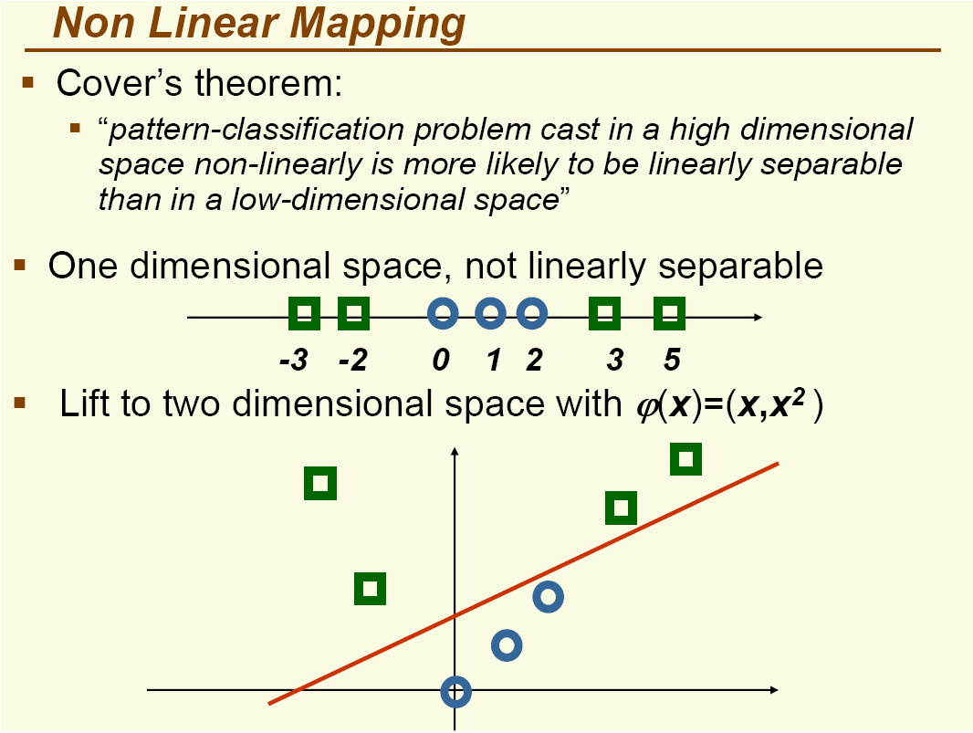

Slide 17
Mapping Data to a High-Dimensional Space
Find function Φ(x) to map to a different space, then SVM formulation becomes:
Data appear as Φ(x), weights w are now weights in the new space
Explicit mapping expensive if Φ(x) is very high dimensional
Solving the problem without explicitly mapping the data is desirable

Slide 18
The Dual of the SVM Formulation
Original SVM formulation
n inequality constraints
n positivity constraints
n number of ξ variables
The dual of this problem
n positivity constraints
one equality constraint
n number of α variables (Lagrange multipliers)
Objective function more complicated
Data only appear as Φ(x_{i}) ⋅ Φ(x_{j})

